Slide 1

Phishing Awareness Training
Date 20 JULY,2025 Presented by
Araj Fatima Intern at CodeAlpha

Slide 2
Training Objectives
Understand Phishing Fundamentals
Identify Phishing Emails and Fake Websites
Learn Social Engineering Tactics
Apply Safe Browsing and Email Habits
Respond to Phishing Attempts
Reinforce Knowledge with Real Examples and Quizzes

Slide 3

Understand Phishing Fundamentals
Phishing is a type of online scam where attackers pretend to be someone you trust like a bank, school, or government and trick you into giving personal information (passwords, credit card numbers, etc.).
Phishing can lead to identity theft, money loss, and even access to confidential systems (like a school or office network).
You get an email from “Your Bank” saying “Your account is blocked! Click here to fix it.” That link may lead to a fake site that steals your login info.

Slide 4
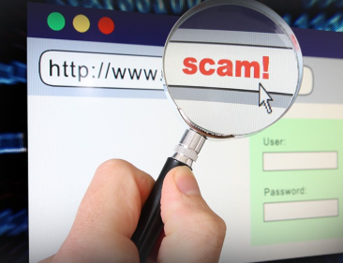
Identify Phishing Emails and Fake Websites
Suspicious Email Address Looks close to real but has misspellings (e.g., paypa1.com).
Urgent or Threatening Language “Account suspended!” or “Act now!” to cause panic.
Generic Greetings Uses “Dear Customer” instead of your name.
Unexpected Links or Attachments Be cautious if you didn’t expect them.
Spelling & Grammar Mistakes Legit companies rarely make such errors.
Too-Good-to-Be-True Offers Promises of money, prizes, or gifts (red flag!)

Slide 5

How to Spot a Fake Website
Fake websites mimic real ones to steal login credentials.
URLs may look almost identical but with slight changes
Real: netflix.com
Fake: netf1ix.com or netflix-security.com
Don’t click on links in suspicious emails.
Manually type the website address in your browser to access it safely.

Slide 6


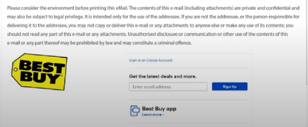
Structure of Phishing Email
01 Header
In this graphic we see an example of a phishing email that looks to be from Best Buy electronics retailer. We examine the 3 parts of this email to learn more about this phishing attempt. If you were a recent customer of Best Buy you might be alarmed at an unexpected charge and may be tempted to open the attachment or click on a link to find out more. This is what attackers are hoping for.
02 Body
03 Footer

Slide 7
Header
Contain Sender’s name, email address, date, and subject line.
Email addresses may look similar to official ones but often include subtle changes or extra characters (e.g., support@bestbuy.com.us).
Subject lines are often urgent or alarming, such as “Receipt for your online purchase,” to provoke immediate action.
Contain The main message, usually encouraging you to click a link or open an attachment.
Generic greetings like “Dear Customer” or even a stolen name like “Michael.”
Links that appear trustworthy but redirect to malicious websites.
Scare tactics, such as mentioning an unauthorized charge, are common to pressure quick action.
Body
Contain Branding, legal disclaimers, and call-to-action buttons like “Download App” or “View Receipt.”
Fake logos and branding copied from legitimate companies.
Click bait buttons that lead to harmful downloads or login pages designed to steal your credentials.
Overuse of legal text to make the email look professional and convincing.
Footer

Slide 8
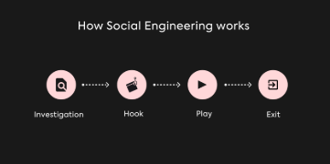
Learn Social Engineering Tactics
Social engineering is when attackers manipulate people into revealing sensitive information.

Slide 9
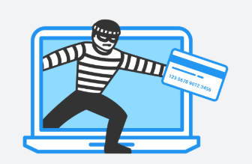
Common Tactics Used
Impersonation Pretending to be a trusted person (e.g., IT staff, manager, or bank official).
Pretexting Creating a fake scenario to trick you into sharing private info (e.g., "I’m from HR, I need your login to update your details").
Baiting Offering something attractive (like free software or gifts) to get you to click or download malware.
Tailgating Following someone into a restricted area without proper access.
Urgency & Fear Making you feel pressured or scared to act fast, like "Your account will be blocked!“.

Slide 10
Apply Safe Browsing and Email Habits
Safe Browsing Tips
Safe Email Practices
Use HTTPS Websites Only enter personal info on websites with https:// and a padlock icon.
Avoid Clicking Suspicious Links Hover over links to check the real URL before clicking.
Update Your Browser Regularly Modern browsers have built-in security to block dangerous sites.
Don’t Download from Unknown Sources Only install apps or software from trusted, official websites.
Verify the Sender Check email addresses closely for misspellings or strange domains.
Don’t Open Suspicious Attachments Especially if the email is unexpected or looks unprofessional.
Report Phishing Emails Use your email platform’s “Report Phishing” button or tell your IT team.
Use Two-Factor Authentication (2FA) Adds a second layer of protection to your accounts.

Slide 11
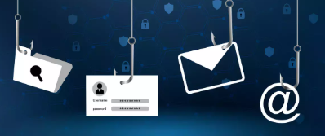
Respond to Phishing Attempts
Don’t click links or download attachments from suspicious emails.
Do not reply to phishing messages this confirms your email is active.
Report the phishing attempt to your IT department or email provider.
Block the sender to prevent future contact.
Delete the email immediately after reporting.
Run antivirus scans if you accidentally clicked or downloaded anything.

Slide 12
S
Reinforce Knowledge with Real Examples
Fake Bank Alert
You receive an email saying: “Your account has been suspended. Click here to reactivate.”
The email uses your bank’s logo and urgent language.
But the sender is support@bank-secure-login.com (not the real bank).
Real Action (Don't click! Go to your bank's website directly by typing the URL.)
Online Store Offer
You get a message: “You’ve won a $100 Amazon gift card!”
It looks official and has the Amazon logo, but the link goes to amzon-surprise.com.
Real Action (Hover over the link to check the real address before clicking.)
Social Media Message
A friend messages you: “Hey, is this you in this video?” with a link.
You click it, and it asks you to log in to Facebook again.
The site is actually a look-alike login page.
Real Action (Don’t log in! Confirm with your friend through another app or call.)

Slide 13
Reinforce Knowledge with Quizzes
A type of Phishing which uses texting is called what?
Whaling
Smishing
Spear Phishing
SEO Phishing

Slide 14
Correct Answer
A type of Phishing which uses texting is called what?
Whaling
Smishing
Spear Phishing
SEO Phishing

Slide 15
How many common types of Phishing are there?
5
7
11
4
6
8

Slide 16
Correct Answer
How many common types of Phishing are there?
5
7
11
4
6
8

Slide 17
THE END

